Slide 1
Living with HIV, on Treatment for life, and growing older :the impact on body and mind
Luís Mendão – GAT/Coalition Plus/EATG

Slide 2

Ageing with HIV it’s a big EATG project since December 2015 till June 2018 witch the goals were:
To increase knowledge on HIV and Ageing medical and related psychosocial aspects from a lifecycle perspective.
To identify and raise awareness regarding unmet care needs for PLHIV/AIDS.
To provide networking opportunities for establishing collaborative efforts to advocate for priorities in the HIV and ageing domain.
For more details please visit https://www.ageingwithhiv.com/

Slide 3

We are also deeply involved in the initiative HIV OUTCOMES that for a year-long collaborative process captured the perspectives and expertise of people living with HIV, clinicians, public health professionals, and the wider HIV community.
The compiled recommendations were launched at the European Parliament with cross-party support from Members of the European Parliament on 29 November 2017.
http://hivoutcomes.eu/

Slide 4
HIV OUTCOMES RECOMENDATIONS:
Adopt an integrated, outcomes-focused, and patient-centred approach to long-term HIV care
Expand national monitoring of long-term HIV care and outcomes
Fund cohort studies to provide information on the long-term health of people living with HIV
Erase (and monitor) stigma and discrimination within health systems
Upscale involvement of the HIV community in priority setting at country level

Slide 5
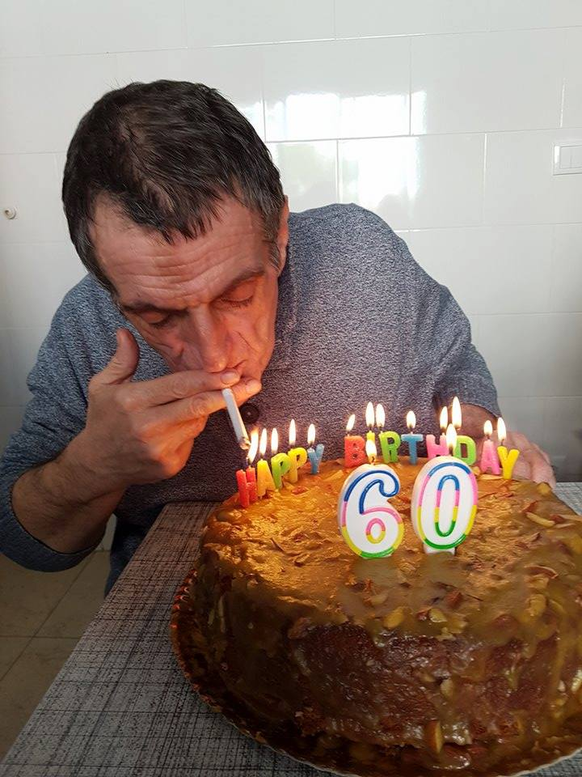
I’m Portuguese, 60y diagnosed 22years ago AIDS C3 2CD4, HCV, dying, CMV retinitis both eyes, etc.
First treatment
Norvir, 1,2g/three time/day , D4T twice, DDI twice, ganciclovir 3 times/day, bactrim 3/times week etc.
10 intakes a day all with food restrictions,
Previous 5 years went to Healthcare several times, herpes zortes, molluscum, pneunomia, alopecia areata, weith loss, extreme fatige, candida alb. Diagnose depression major

Slide 6
Final considerations

